Slide 1
Git and GitHub Manage your Software Development Portfolio
Prof. Hsi-Min Chen
Dept. of Information Engineering and Computer Science
Feng Chia University

Slide 2

What is the significance of version control？
You are writing report.
How can you backup it?

Slide 3
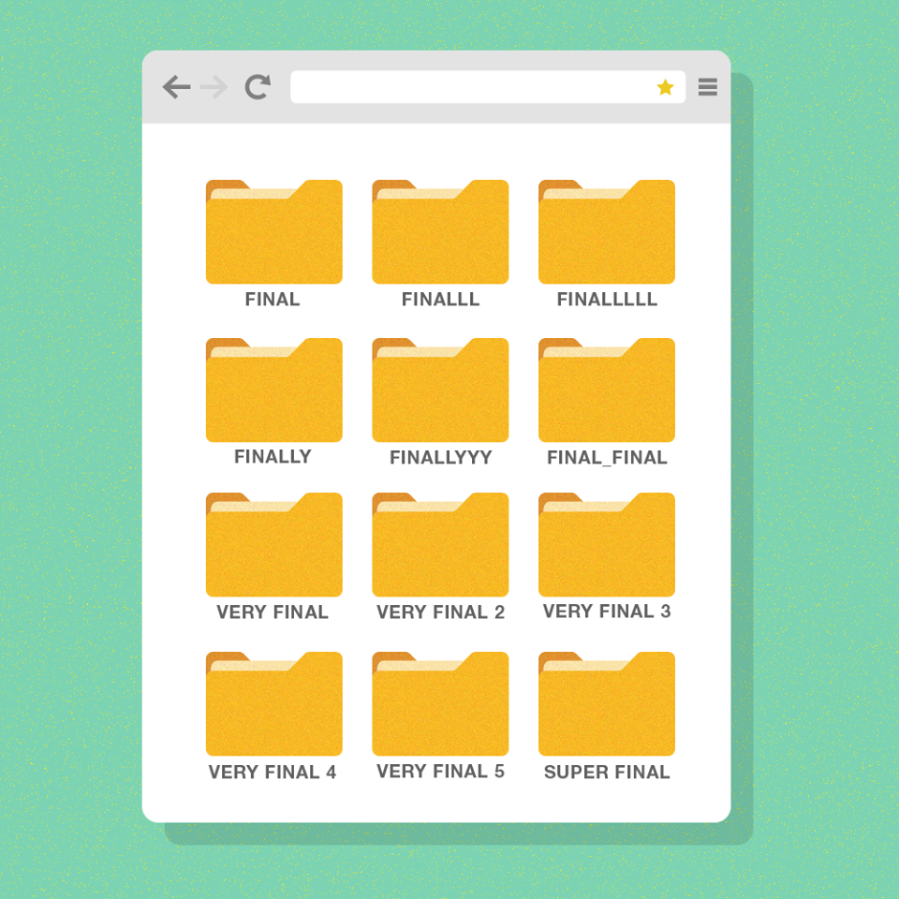
What will be happened？
Many versions
?
?
?

Slide 4




What will be happened？
Working with others...

Slide 5
Why we need version control?
Every development path leaves its traces
Track history
If something is altered, it can be reverted.
Enable collaboration
Collaborative modifications preserve individual integrity.
Collective alterations foster transparency regarding each other's changes.

Slide 6

What is version？
version 1
version 2
version 3
version 4
version 5
Day 1
Day 2
Day 3
Day 4
Day 5

Slide 7

Version Control
Version control is employed for the management and tracking of various components:
Source code
Test code
Server configuration files
Documents
Books
Website contents

Slide 8

What is Git?
Distribute version control system
Open-source software
Vibrant open source community
Rich Ecosystem Support
Suitable for many different types of projects and workflows
Linux OS ready-to-use Git management

Slide 9




Distributed version control system
Distributed version control system has three main characteristics
Each user has its own local project history (repository)
Users have the capability to work offline
It facilitates convenient synchronization of distributed repository contents.
Remote
repository
local side
repository
local side
repository

Slide 10
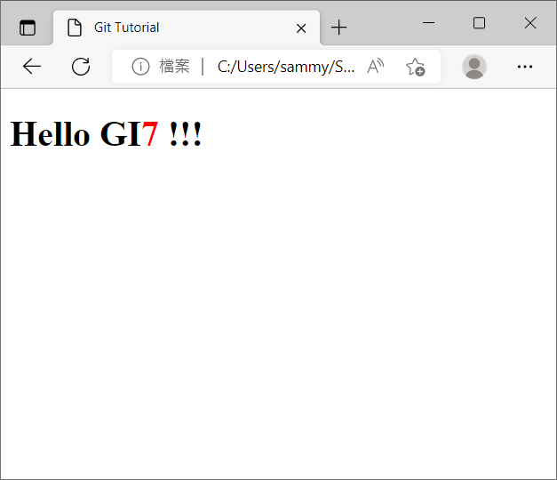
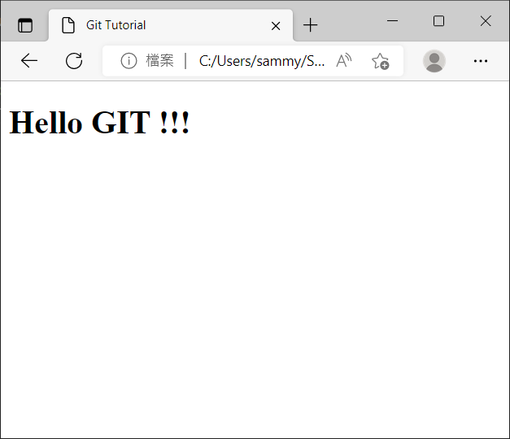

Git Commits
Git captures the state of the project at various stages during the project development lifecycle
Each recorded state is referred to as a commit, representing a snapshot of the project at a specific moment in time.
A
B
commits
Code with bug
Bug was fixed

Slide 11
What is Git Repository?
A series of project snapshots or commit
commit 1
commit 2
commit 3
A
B
C
commits
index.html (v1)
index.html (v1)
./img/logo.png
index.html (v2)
./img/logo.png

Slide 12
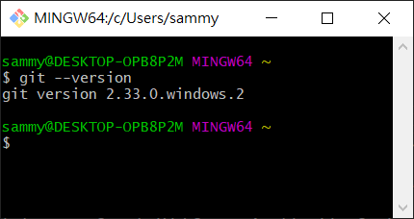
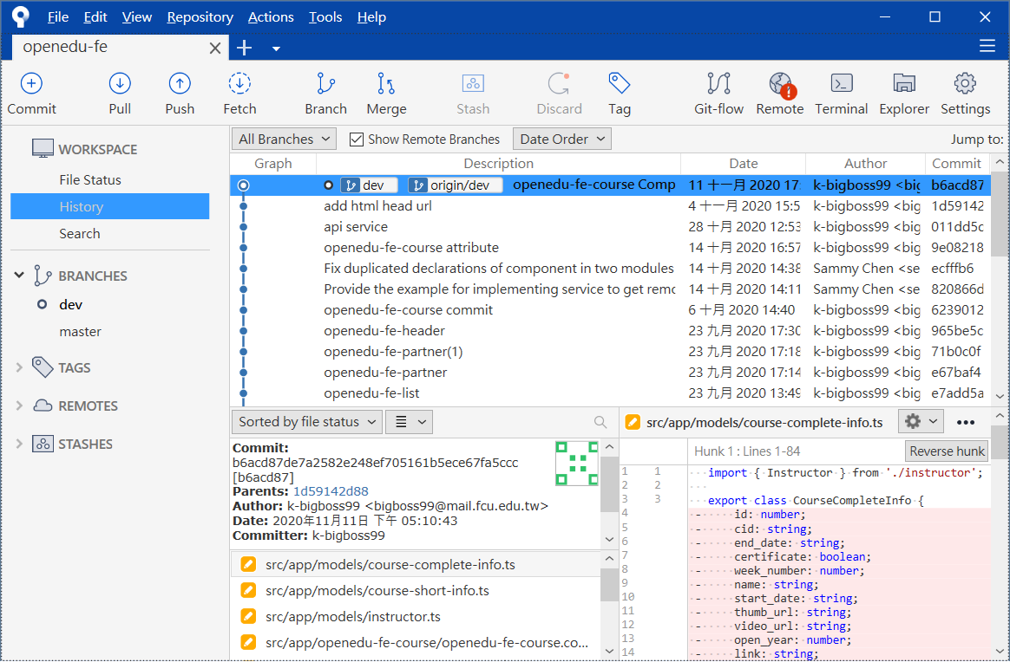
Git tool
Command line and Graphical User Interface (GUI)
remote
repository
local side
repository
local side
repository

Slide 13
SourceTree Installation
Graphical Git client tool
Install SourceTree
https://www.sourcetreeapp.com/
Other graphical Git client tools
https://git-scm.com/downloads/guis/

Slide 14
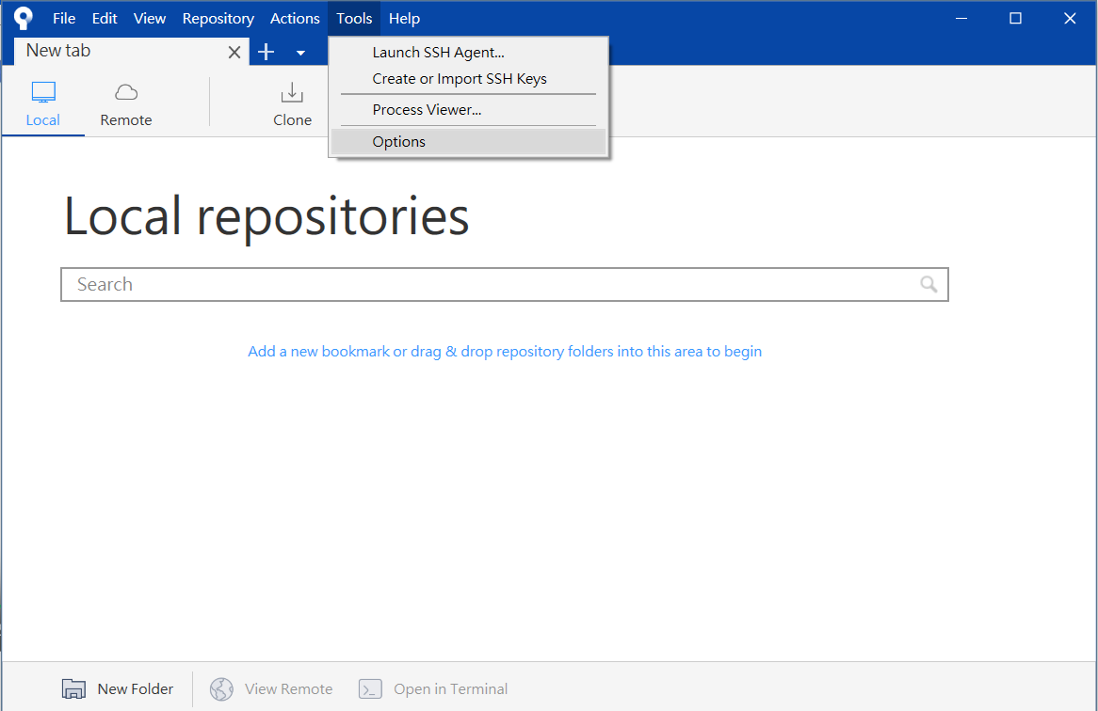
SourceTree
Configure Git user information

Slide 15
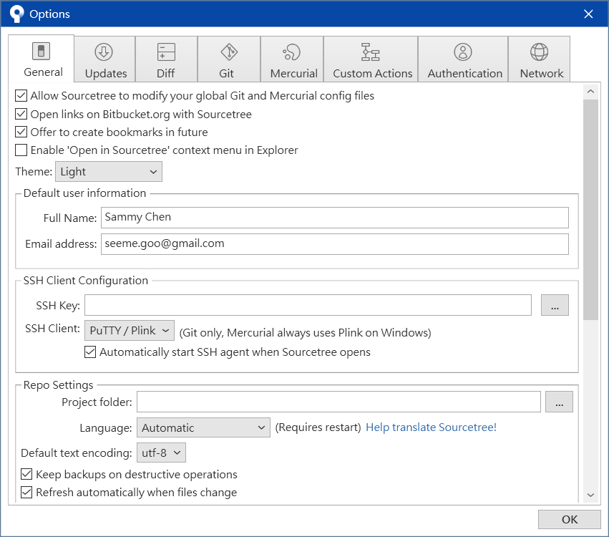
SourceTree
Configure Git user information

Slide 16


Git Locations
Working Tree
Stage Area/Index
Local Repository
Remote Repository
Files and directory location for a single commit

Slide 17
Git Locations
Working Tree
Stage Area/Index
Local Repository
Remote Repository
Files undergoing changes for the upcoming commit.

Slide 18
Git Locations
Working Tree
Stage Area/Index
Local Repository
Remote Repository
Contains all commit history

Slide 19
Git Locations
Working Tree
Stage Area/Index
Local Repository
Remote Repository
Contains all commit history

Slide 20
Git Locations
Working Tree
Stage Area/Index
Local Repository
Remote Repository
Project Directory

Slide 21
Git Locations
Working Tree
Stage Area/Index
Local Repository
Remote Repository
my-prj/
working tree
/.git

Slide 22
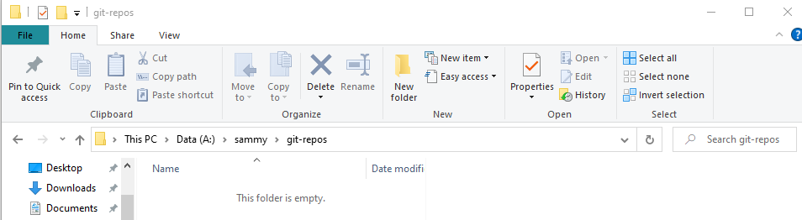
Create a local repository
Open the file explorer and create the root directory for the version control project.
Used to manage all Git projects
e.g., directory name git-repos

Slide 23
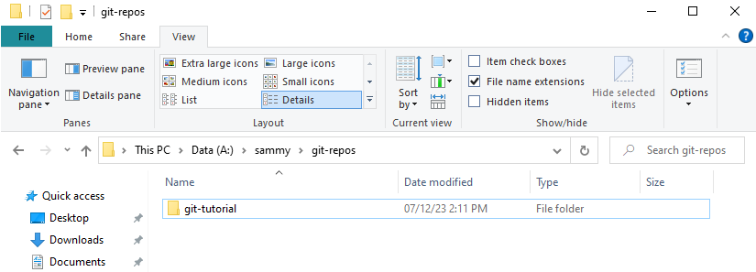
Create a local repository
Create a version control project directory (Working Tree)
e.g., directory name git-tutorial

Slide 24
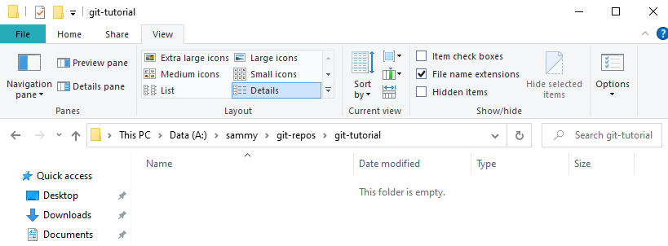
Create a local repository
The current project directory does not have any version control files

Slide 25
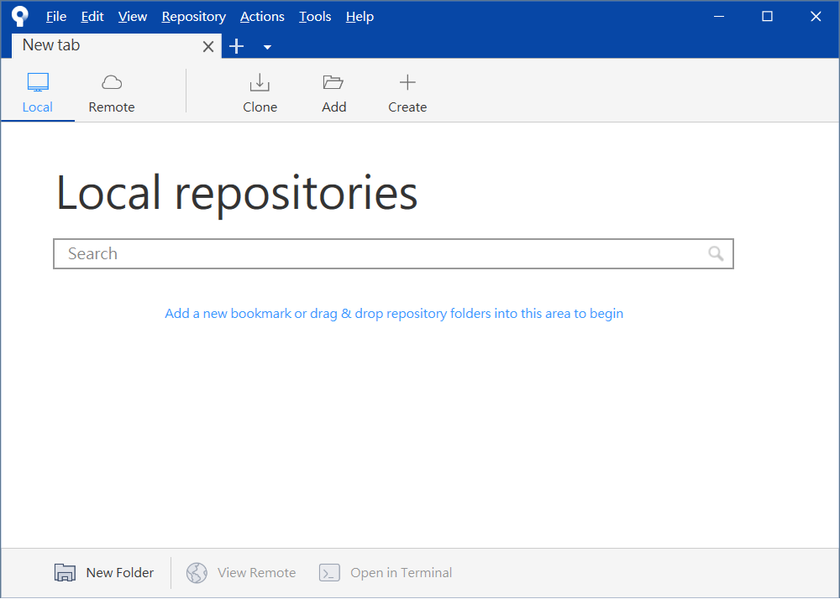
Create a local repository
Open SourceTree and create a local repository

Slide 26
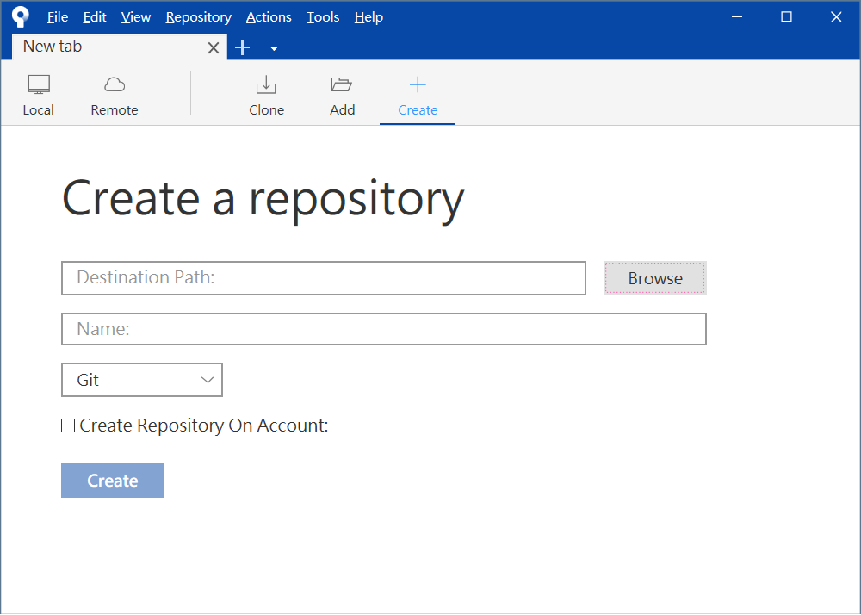
Create a local repository
Configure version control working directory

Slide 27
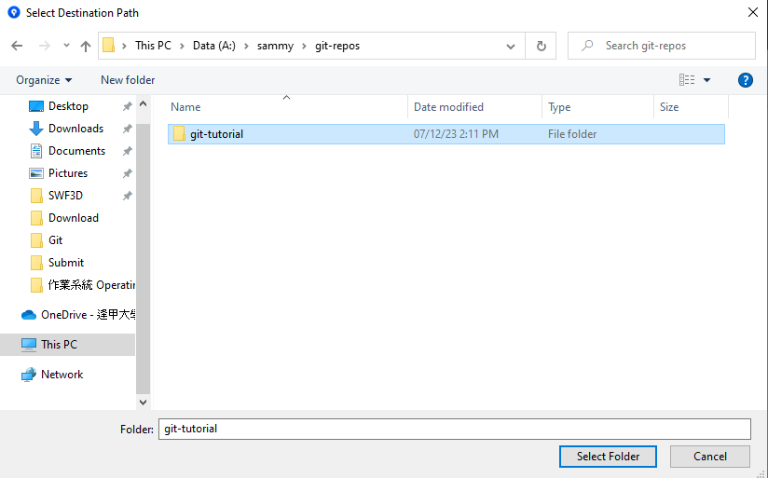
Create a local repository
Select version control working directory

Slide 28
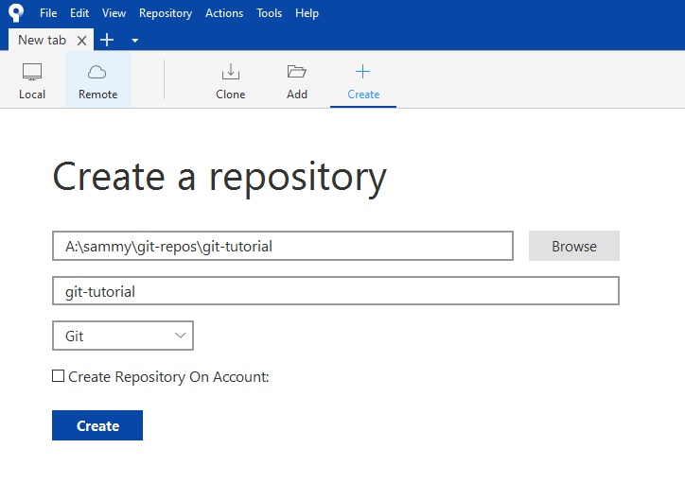
Create a local repository

Slide 29
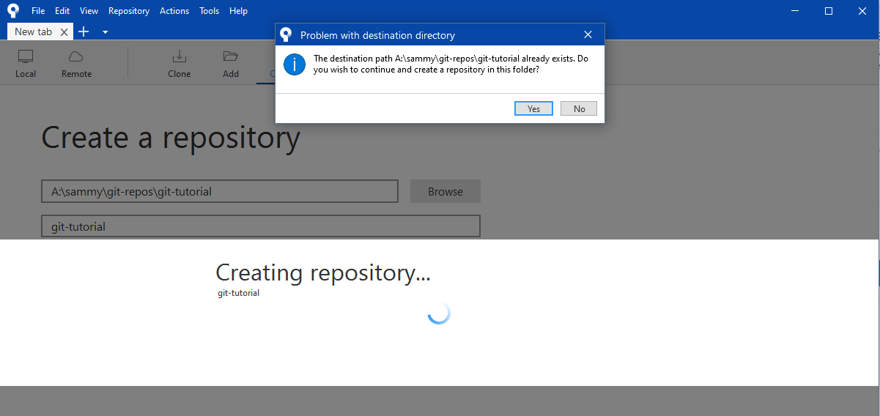
Create a local repository

Slide 30
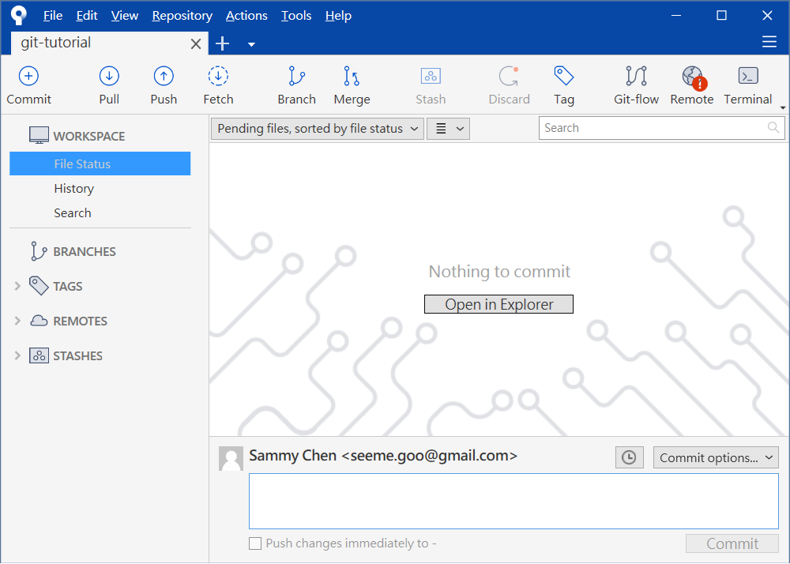
Create a local repository
Open SourceTree and successfully create a local repository.

Slide 31
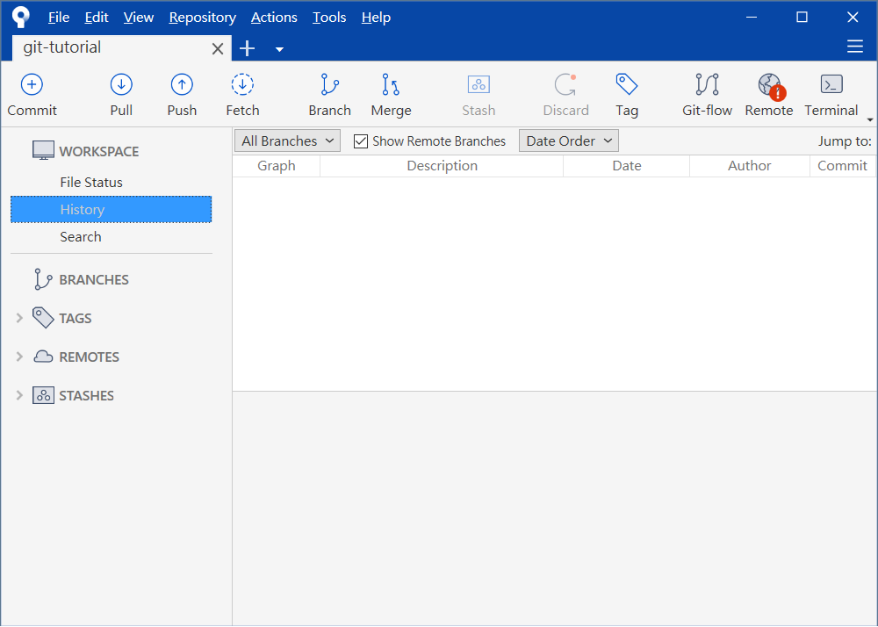
Create a local repository
Open SourceTree and successfully create a local repository.

Slide 32
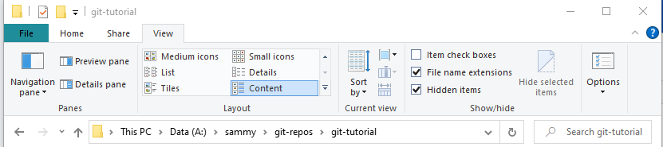
Create a local repository
Open the show hidden items

Slide 33
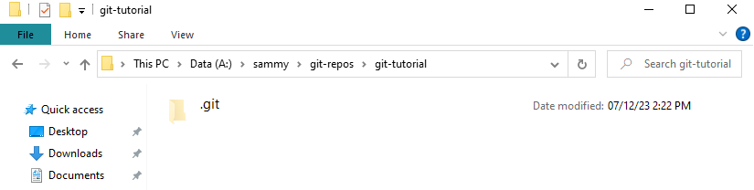
Create a local repository
Open the file manager and view the local repository (.git)

Slide 34

Examine the file status.
Working Tree
Stage Area/Index

Slide 35
Commit files to local repository
Open the file explorer, open the display extension

Slide 36
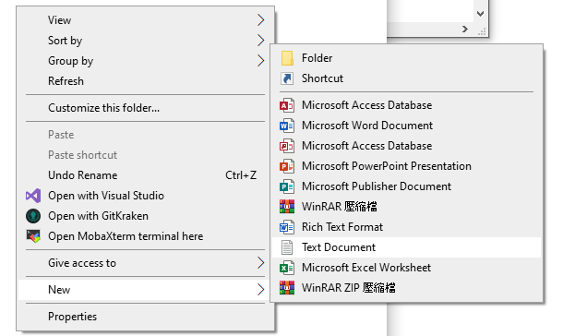
Commit files to local repository
Add untracked files to working directory
e.g., index.html

Slide 37
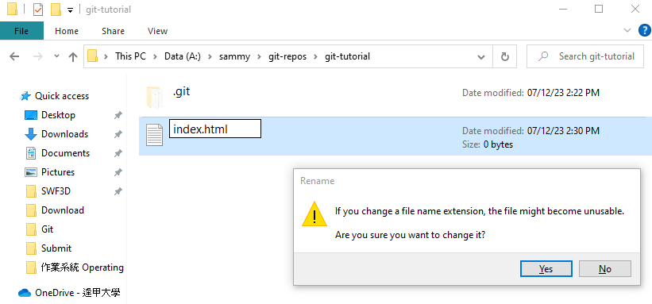
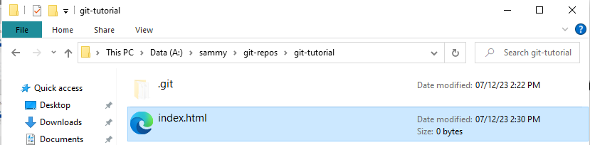
Commit files to local repository
Add untracked files to working directory
e.g., index.html

Slide 38
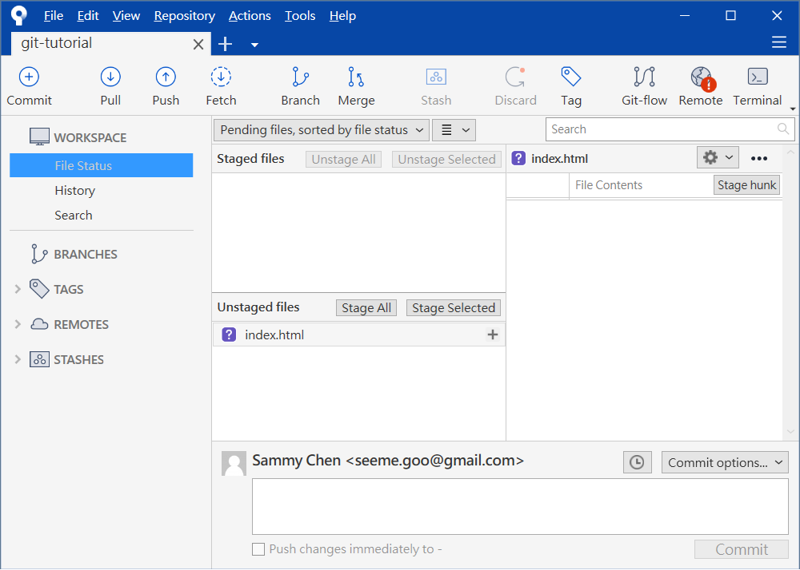
Examine the file status
Working Tree
Stage Area/Index
? indicates an untracked file

Slide 39
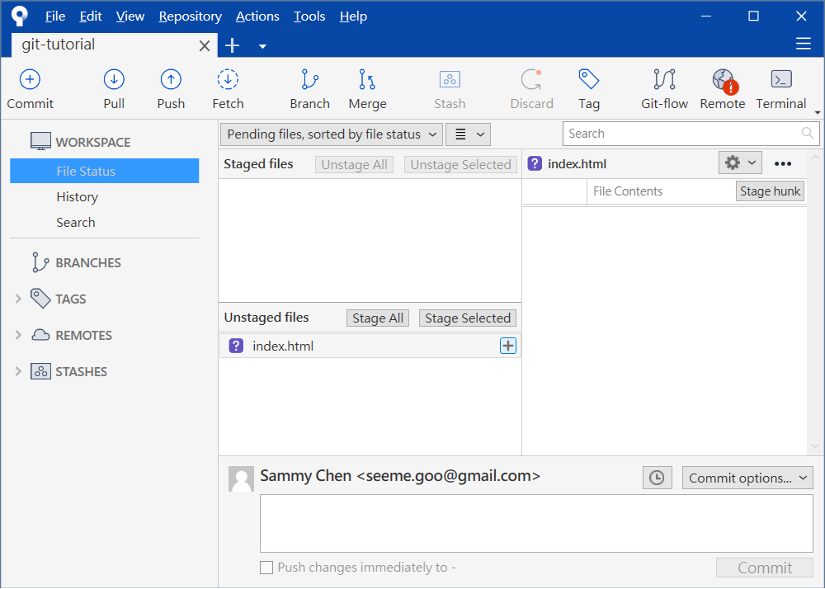
Stage - Untracked file
stage
Working Tree
Stage Area/Index

Slide 40
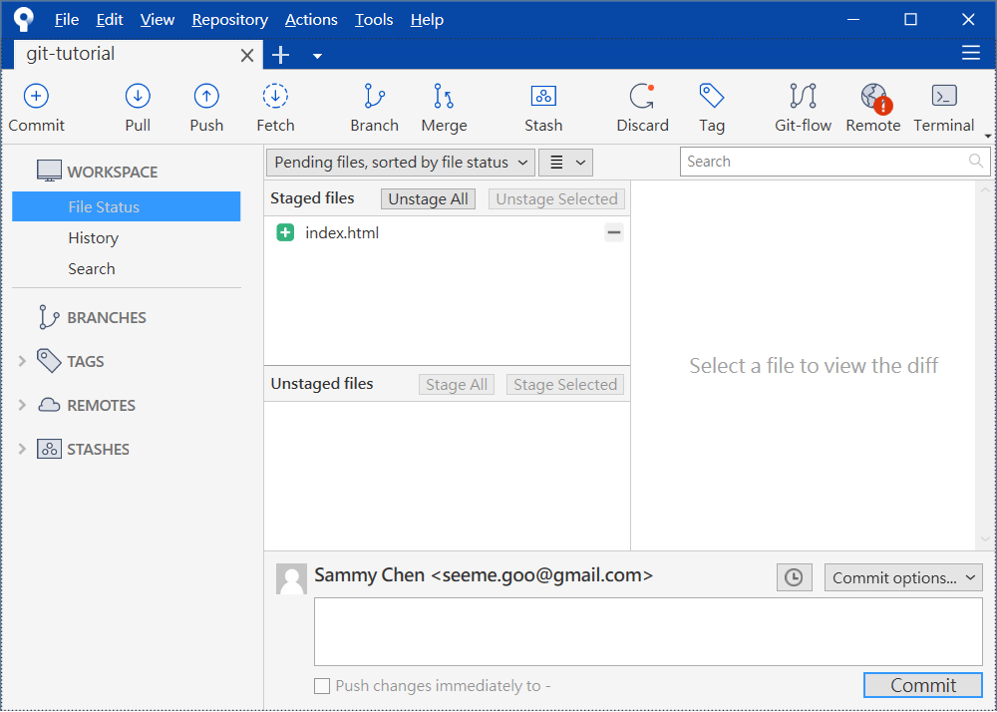
Stage - tracked file
stage
Working Tree
Stage Area/Index

Slide 41
Commit files to local repository
stage
commit
Working Tree
Stage Area/Index
Local Repository
Remote Repository

Slide 42
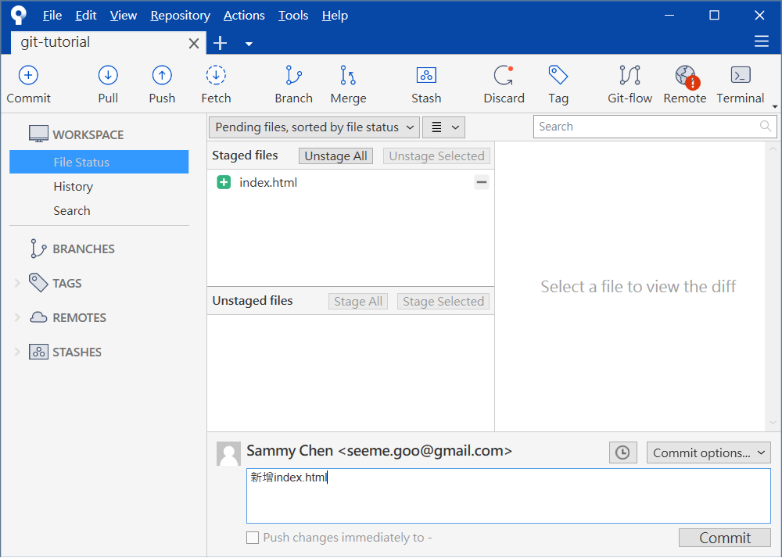
Commit files to local repository
Commit message
commit
Stage Area/Index
Local Repository

Slide 43
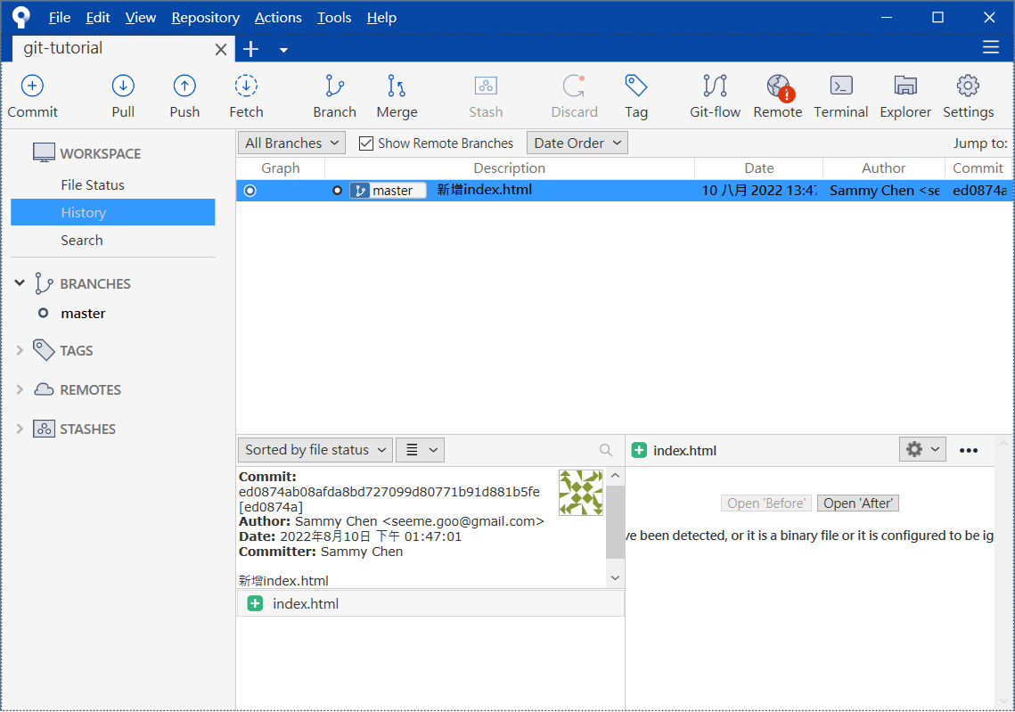
Commit files to local repository
Examine commit history
commit
Stage Area/Index
Local Repository

Slide 44
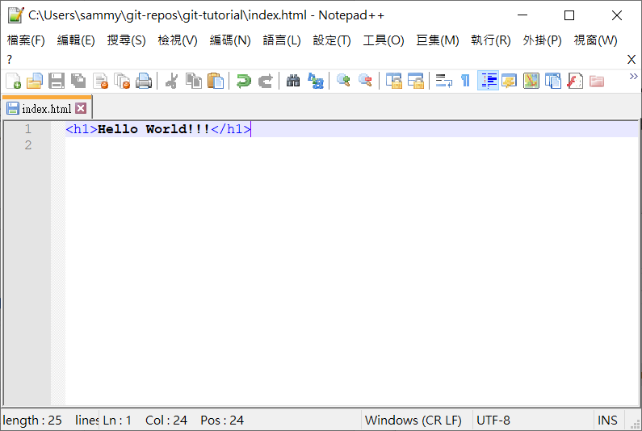
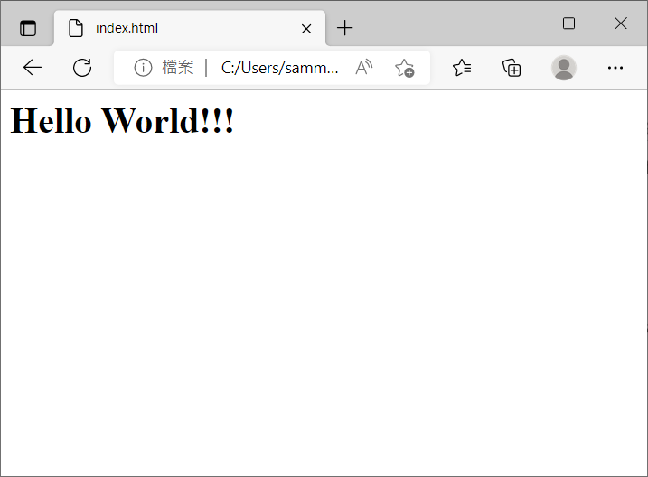
Small improvement - Modifying content
Modify/change index.html in the working tree
<h1>Hello World!!!</h1>

Slide 45
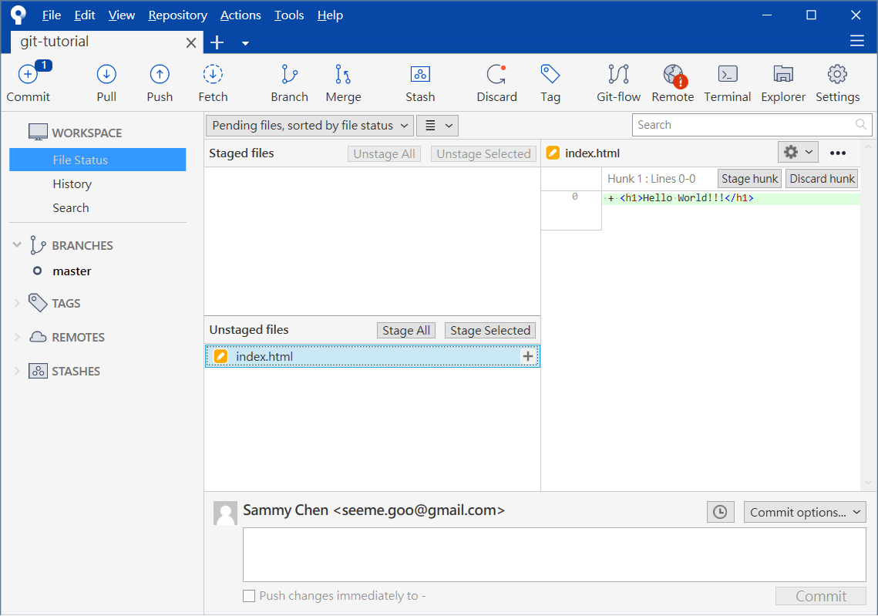
Small improvement - Modifying content
Examine file status
Show the differences from the previous version
Tracked and Modified Files

Slide 46
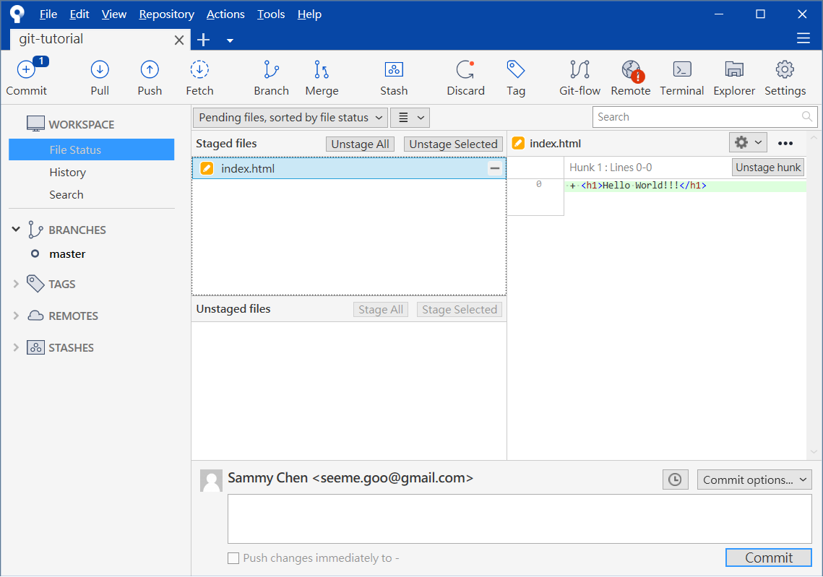
Small improvement - Modifying content
Stage modified/changed files.

Slide 47
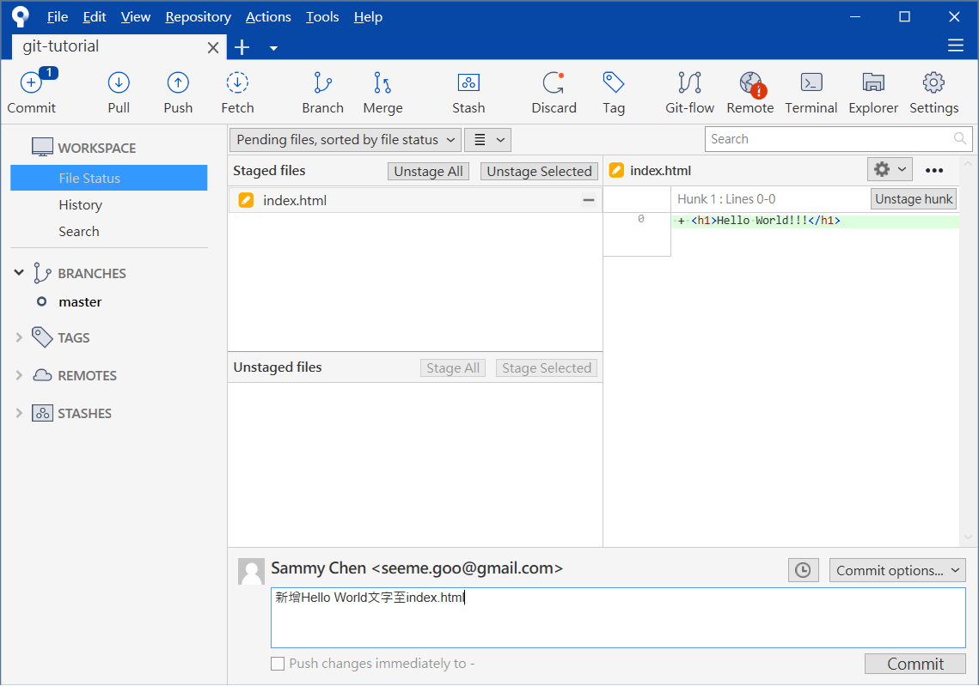
Small improvement – Modifying content
Commit modified/changed files.

Slide 48
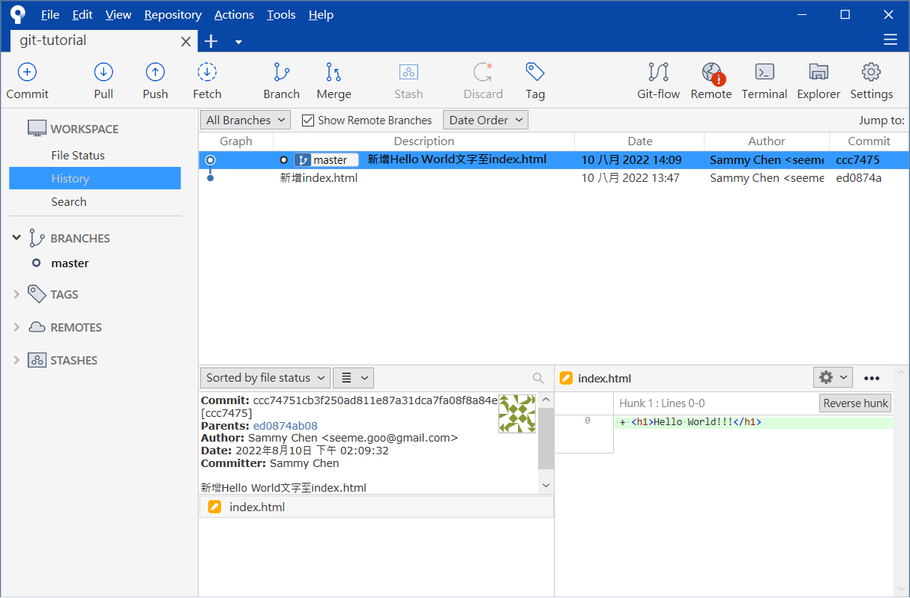
Small improvement - Modifying content
Examine commit history

Slide 49
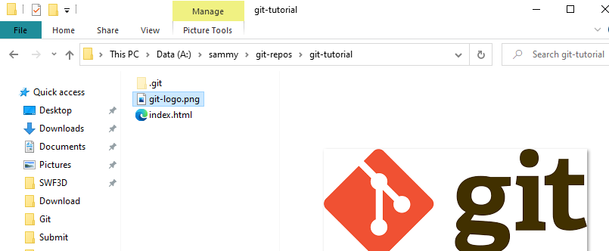
Small improvement - Modifying content
Add untracked images to working directory
e.g., git-logo.png

Slide 50
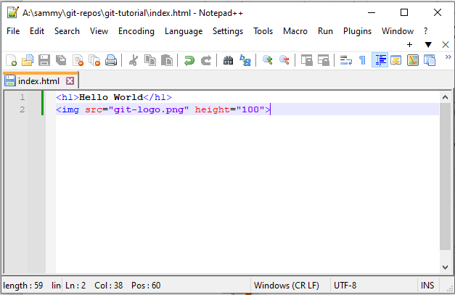
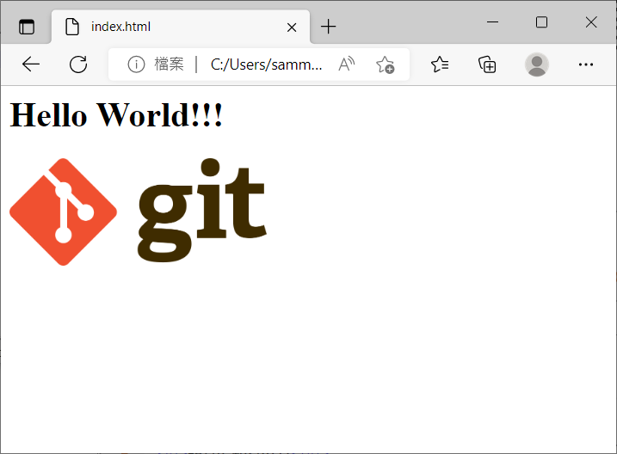
Small improvement - Modifying content
Modify/alter index.html in the working directory
<h1>Hello World!!!</h1>
<img src="git-logo.png" height="100">

Slide 51
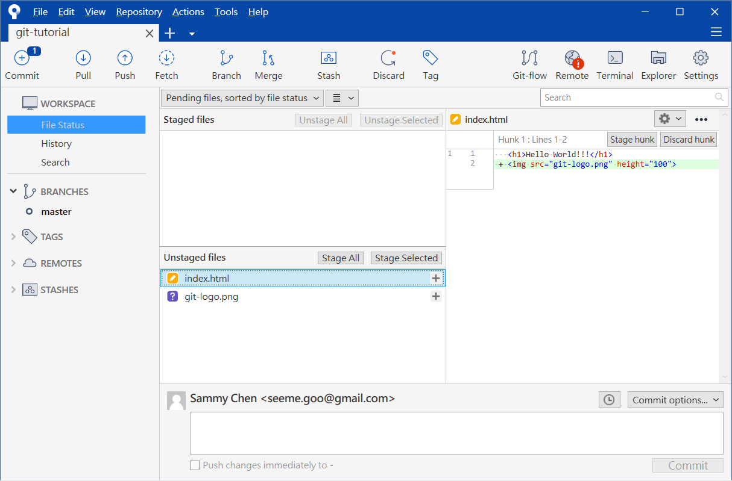
Small improvement - Modifying content
Examine profile status
Show the differences from the previous version

Slide 52
Small improvement - new files
Stage Modified/Changed Files

Slide 53
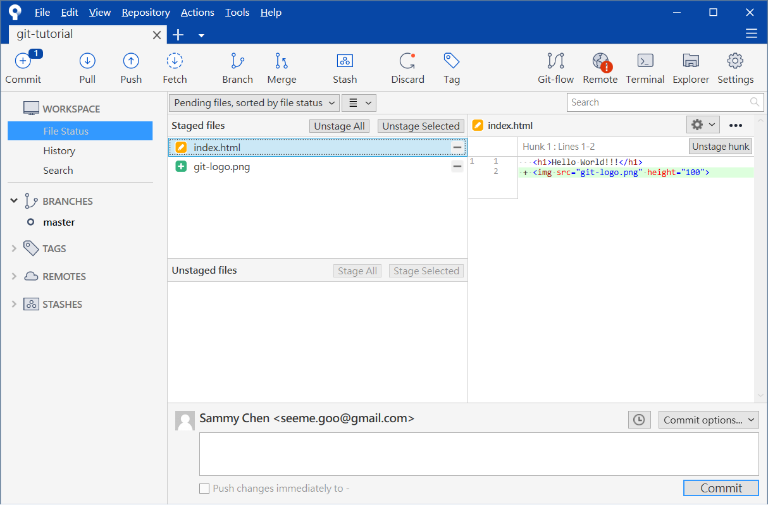
Small improvement - new files
Stage Modified/Changed Files

Slide 54
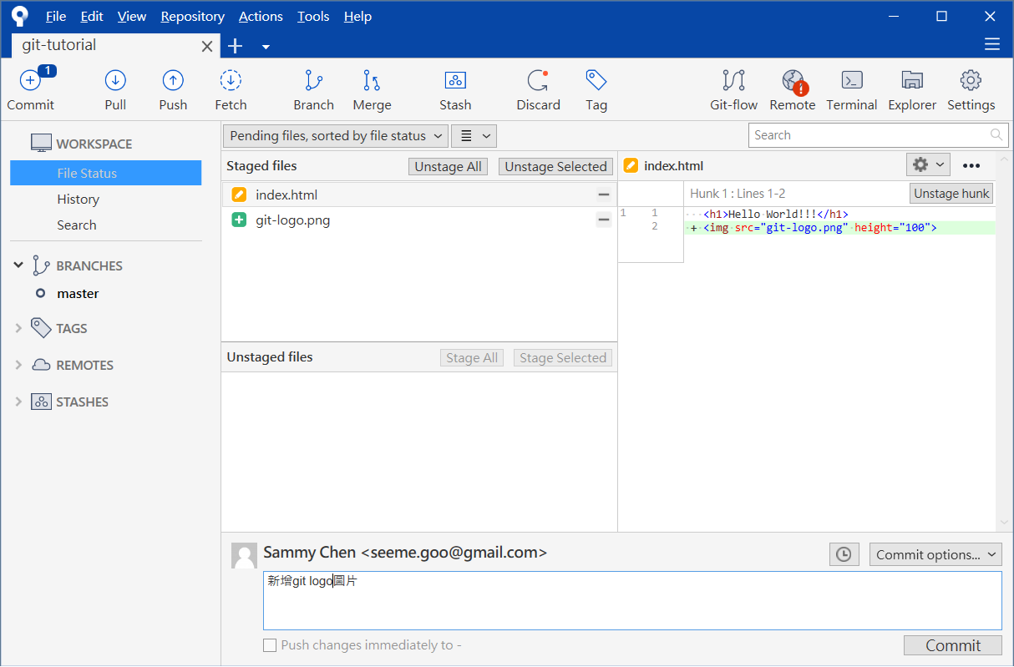
Small improvement - new files
Commit modified/changed files

Slide 55
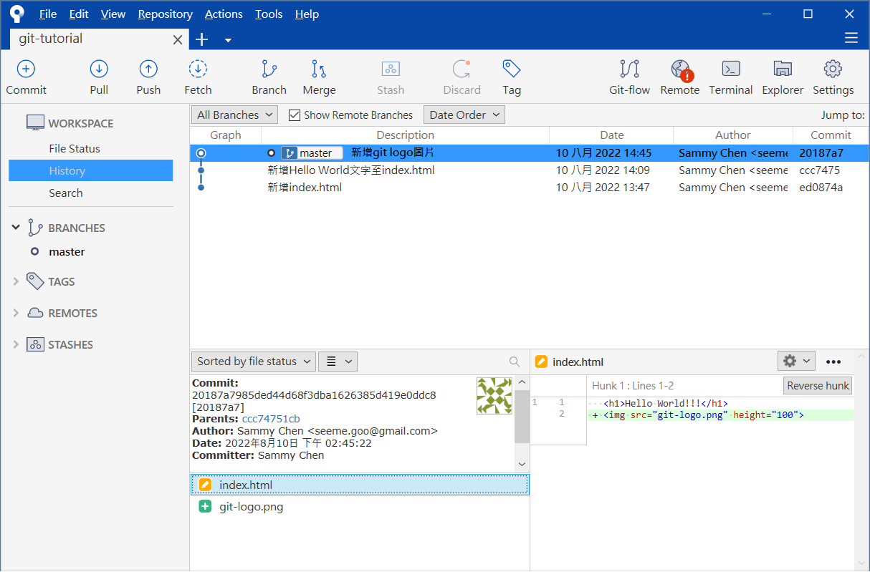
Small improvement - new files
Examine commit history

Slide 56
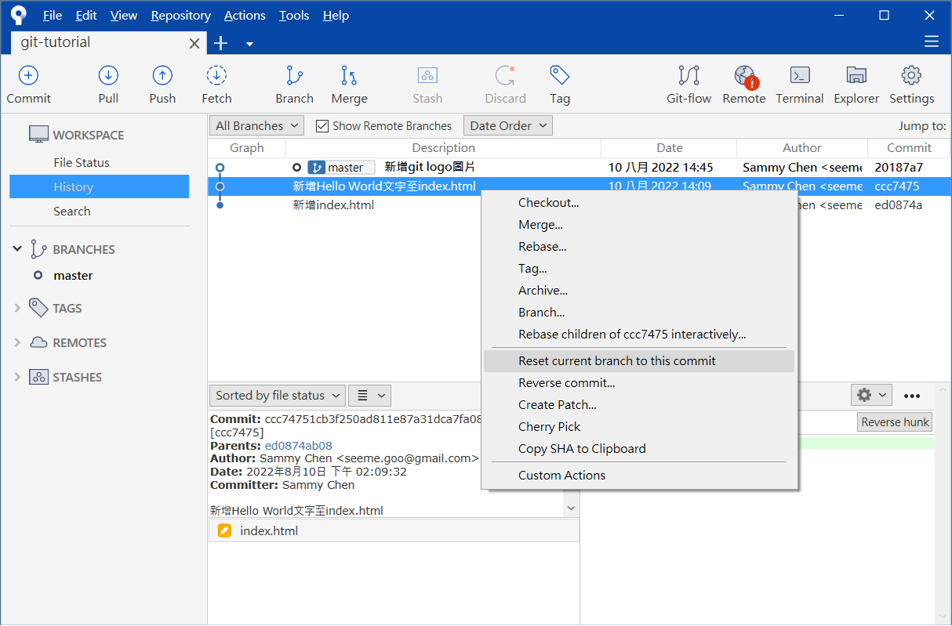
After committing, what should be done if there is regret?
Reset commit history

Slide 57
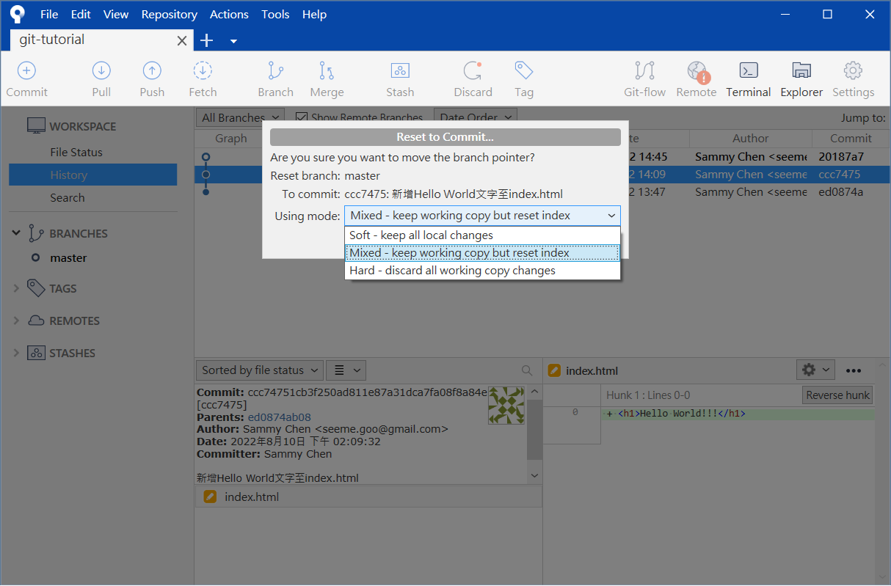
After committing, what should be done if there is regret?
Reset commit history

Slide 58
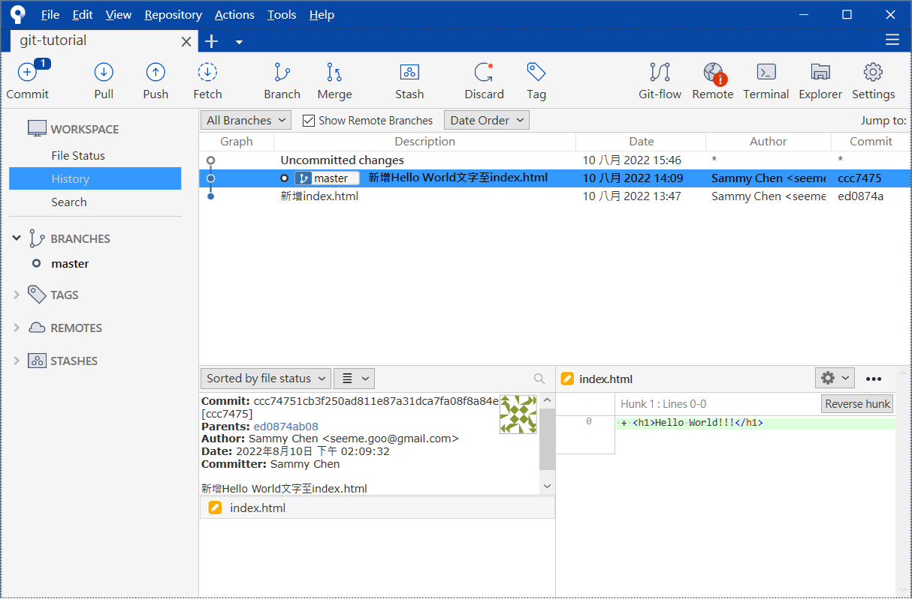
After committing, what should be done if there is regret?
Return to previous commit

Slide 59
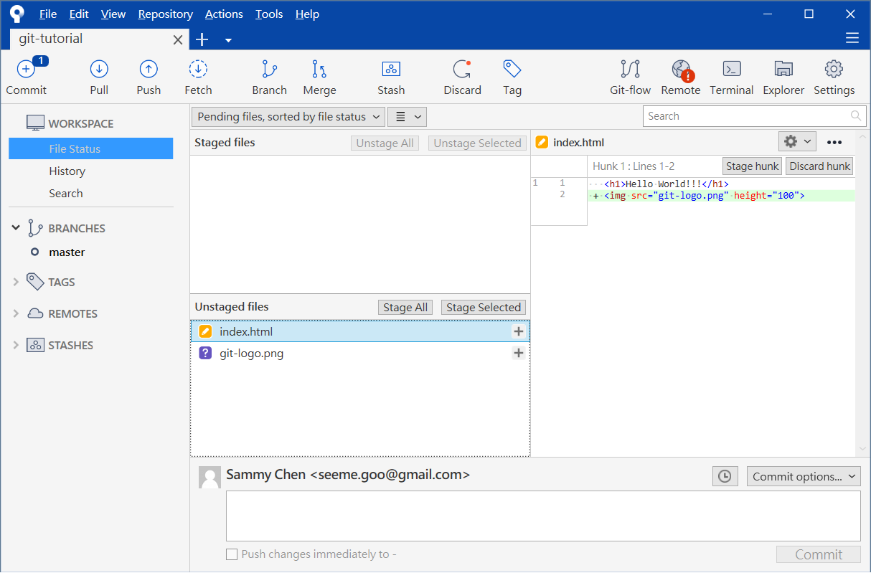
After committing, what should be done if there is regret?
Files that regret commit will be returned to the working tree

Slide 60
Remote repository
A professionally managed repository
Hosted by data center or cloud
Reflects the official status of the project
Authentic core source code
Can be integrated with other systems
Project management system, issue tracking system, etc.
stage
Working Tree
Stage Area/Index
Local Repository
Remote Repository

Slide 61
Remote repository
Remote repository hosting service
GitHub
https://github.com/
GitLab
https://about.gitlab.com/
Bitbucket
https://bitbucket.org/
….

Slide 62
Remote repository
The remote repository is a simplified version of the repository
No user interaction
No working tree and stage area
By convention, the name of the remote repository is suffixed with git
Remote Repository
https://github.com/<username>/<repo-name>.git

Slide 63
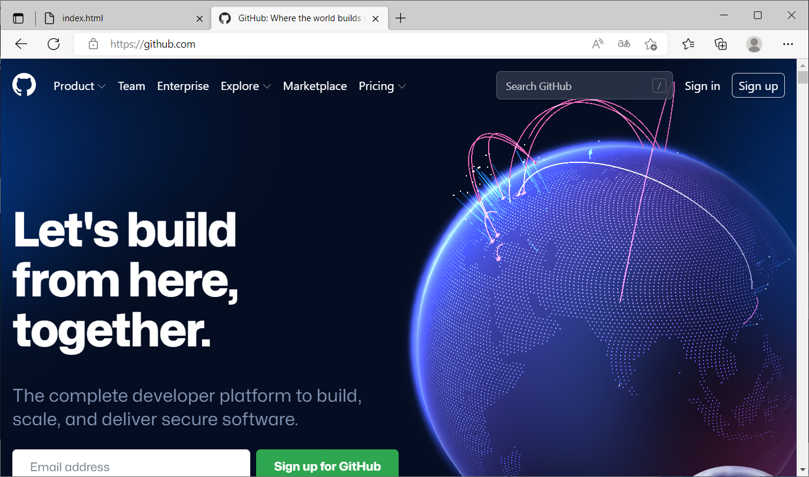
Create a GitHub remote repository
Registration for a GitHub account
https://github.com/

Slide 64
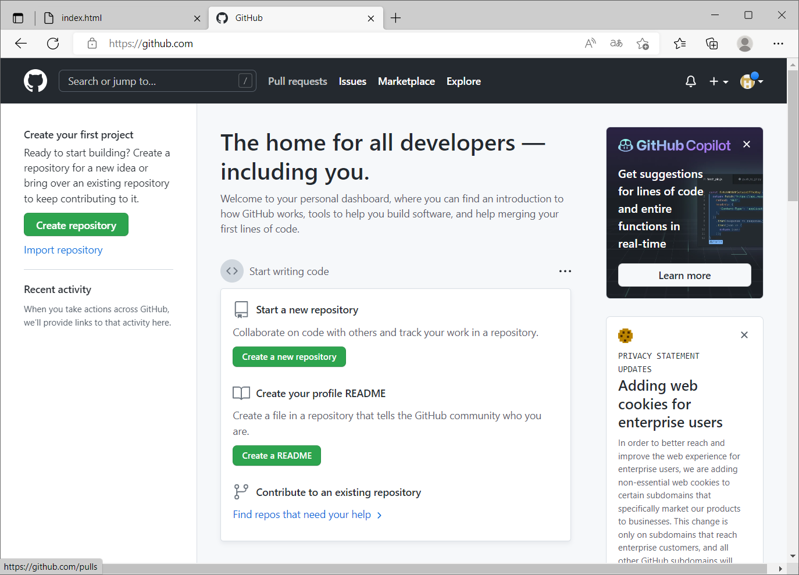
Create a GitHub remote repository
Registration success

Slide 65
Create a GitHub remote repository
Create a remote repository

Slide 66
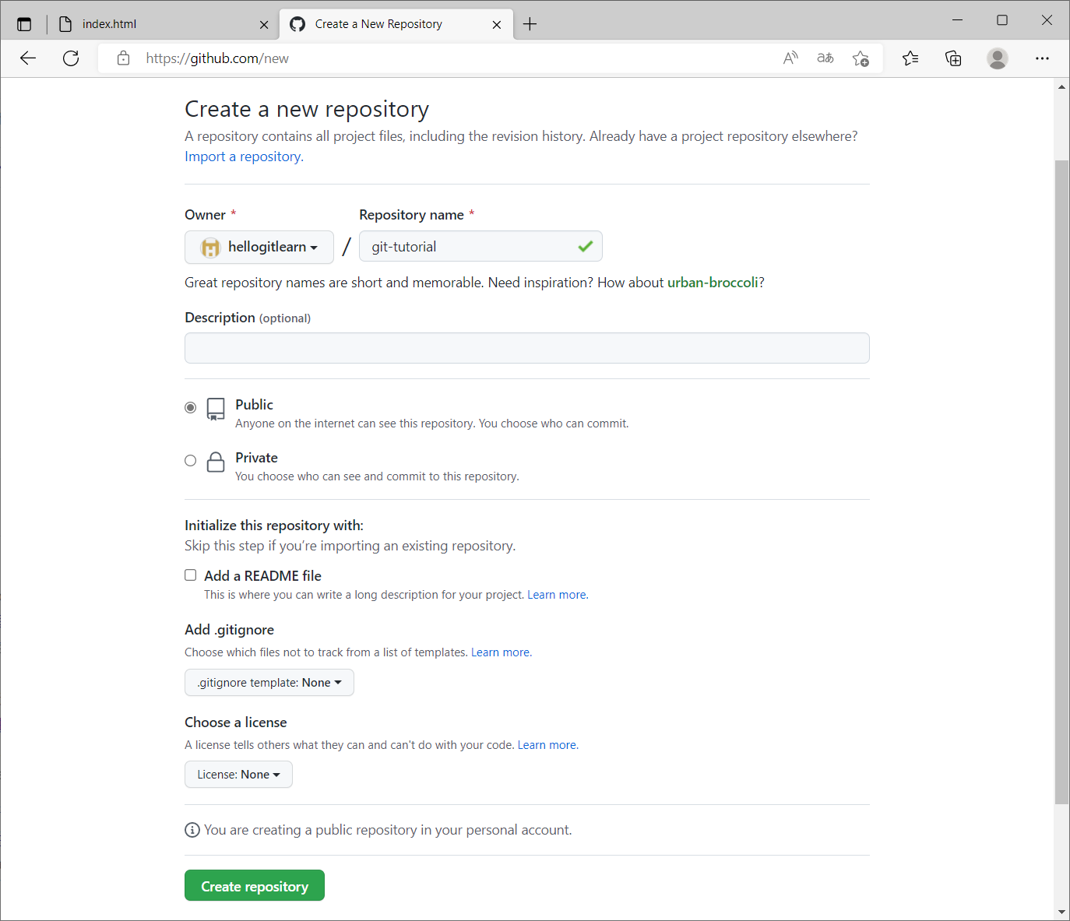

Slide 67
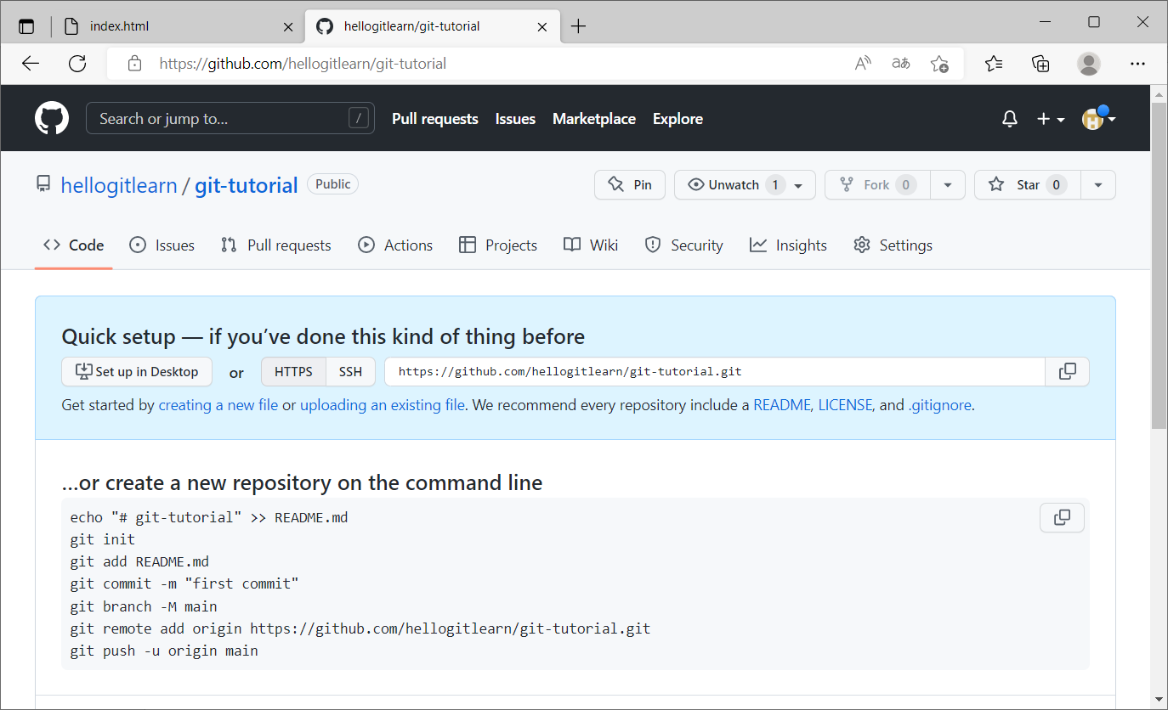
Create a GitHub remote repository
Remote repository creation completed (currently no commit history in the remote repository).
Remote repository name

Slide 68
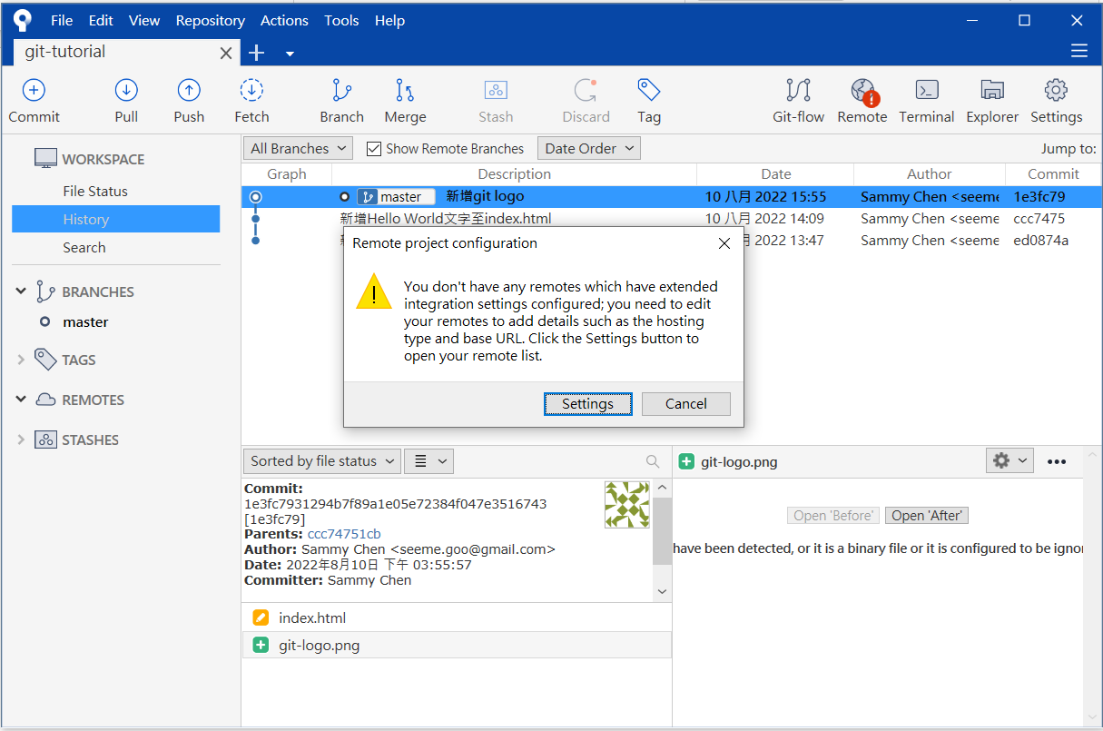
Synchronize remote repository
Synchronize the delivery process of the local repository to the remote repository

Slide 69
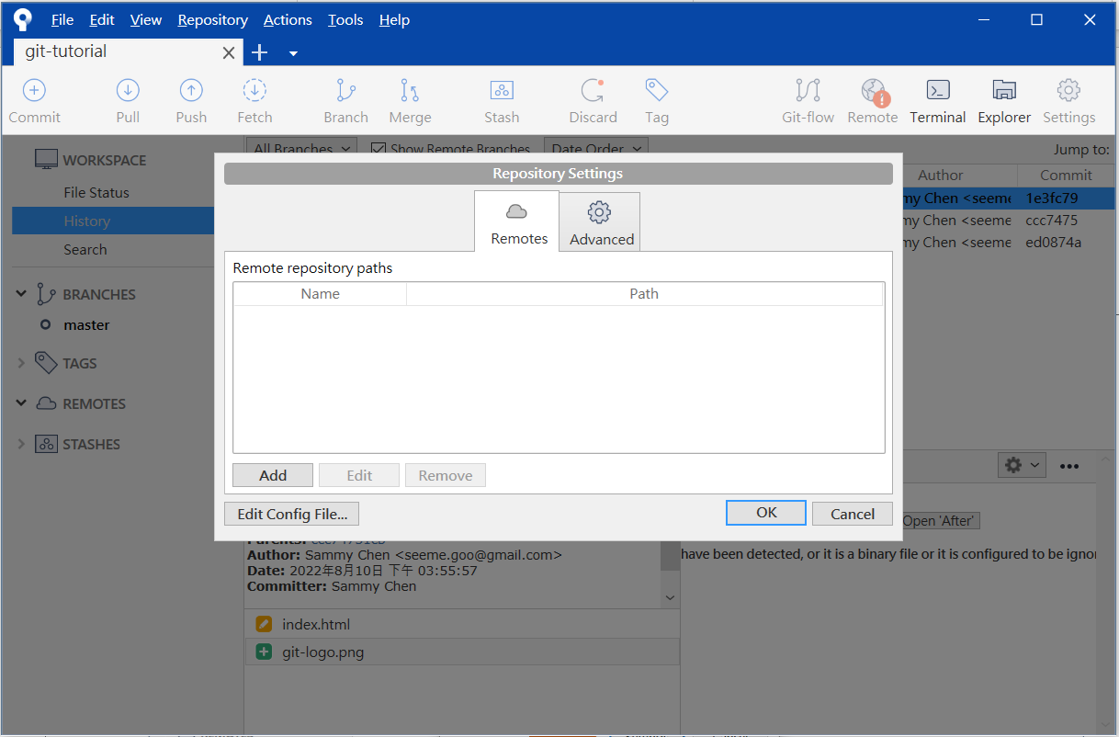
Synchronize remote repository
Configure remote repository

Slide 70

Synchronize remote repository
Configure the remote repository.

Slide 71

Synchronize remote repository
Remote repository configuration completed.

Slide 72

Synchronize remote repository
Local repository successfully linked to the remote repository.

Slide 73
Branch
A software project has one or more branches
All commits belong to branches
A branch can be seen as an independent development branch of the project.
Each software project will have a default branch called main/master
main
A
B
C

Slide 74
Synchronize the remote repository
Push the commit history of a branch from the local repository to the remote repository.
stage
push
Working Tree
Stage Area/Index
Local Repository
Remote Repository

Slide 75

Synchronize the remote repository
Push

Slide 76

Synchronize the remote repository
GitHub default branch name has been changed to main

Slide 77

Synchronize the remote repository
GitHub Login

Slide 78


Synchronize the remote repository

Slide 79

Synchronize the remote repository
Refactor the remote repository

Slide 80
View the commit history on the remote repository

Slide 81

View the commit history on the remote repository

Slide 82

Complete remote repository synchronization

Slide 83


Slide 84
Synchronize the local repository
Clone the commit history of a branch from the remote repository to the local repository.
School
push
Working Tree
Stage Area/Index
Local Repository
Remote Repository
Home
clone
Working Tree
Stage Area/Index
Local Repository
empty local repository

Slide 85

Synchronize the local repository
Open SourceTree and create a copy of the remote repository

Slide 86

Synchronize the local repository
Configure remote repository URL and local working directory

Slide 87

Local repository synchronization completed

Slide 88

Local repository synchronization completed
Open the file explorer to view the contents of the working directory

Slide 89


Small improvement - Modifying content
Modify/change index.html in the working tree
<h1>I love git.</h1>
<img src="git-logo.png" height="100">

Slide 90

Small improvement - Modifying content
Examine profile status
Show the differences from the previous version

Slide 91

Small improvement - Modifying content
Stage - Modified/Changed Files

Slide 92

Small improvement - Modifying content
Commit modified/changed files

Slide 93

Small improvement - Modifying content
Examine delivery history

Slide 94

Synchronize remote repository
Synchronize the new commits to the remote repository using the push command.

Slide 95

Synchronize remote repository
Remote repository synchronization completed.

Slide 96

Synchronize remote repository
Examine remote repositories

Slide 97
non-empty local repository
School
clone
Working Tree
Stage Area/Index
Local Repository
Remote Repository
Home
push
Working Tree
Stage Area/Index
Local Repository

Slide 98
non-empty local repository
School
pull
Working Tree
Stage Area/Index
Local Repository
Remote Repository
Home
push
Working Tree
Stage Area/Index
Local Repository

Slide 99

Synchronize remote repository
Pull

Slide 100

Synchronize remote repository
Pull

Slide 101

Synchronize remote repository
Pull sync complete

Slide 102

GitHub Collaboration - Collaborators
Collaborators are suitable for collaboration among a team
The person responsible for this repository can enter the settings and add the account of collaborators

Slide 103

GitHub Collaboration - Collaborators
Add a collaborator

Slide 104



GitHub Collaboration - Collaborators
Invitation letter
Agree to the invitation
become a collaborator
Waiting for the invitation to agree

Slide 105
GitHub Collaboration - Collaborators
Clone the commit history of a branch from the remote repository (maintained by the owner) to the local repository (maintained by the collaborator).
Student A
push
Working Tree
Stage Area/Index
Local Repository
Remote Repository
Student B
clone
Working Tree
Stage Area/Index
Local Repository
empty local repository

Slide 106
GitHub Collaboration - Collaborators
Collaborators can synchronize their modified commits to the remote repository using the push command.
Other team members can synchronize the latest commit versions from the remote repository to their local repository using the pull command.
Student A
pull
Working Tree
Stage Area/Index
Local Repository
Remote Repository
Student B
push
Working Tree
Stage Area/Index
Local Repository

Slide 107
GitHub Collaboration - Fork & Pull Request
On GitHub, there are numerous open-source projects, and there are certain projects that you are highly interested in contributing to
However, if you are not acquainted with the original repository author, they may be unable to include you as a collaborator
The Fork & Pull Request mechanism provided by GitHub can assist in collaborative efforts in such scenarios

Slide 108
GitHub Collaboration - Fork & Pull Request
Fork & Pull Request workflow:
Initiate the Fork action, creating a copy of the repository you wish to contribute to under your own GitHub account.
Since the copied repository is now under your own GitHub account, you have full permissions to make any desired modifications.
After making the desired changes, push them back to your own account's repository.
Then, on GitHub, submit a Pull Request to the original author, notifying them that you have made contributions and requesting a code review.
Once the original author has reviewed and approved the changes, they can proceed to merge your modifications into their repository.

Slide 109

GitHub Collaboration - Fork & Pull Request
Initiate the Fork action to create a duplicate copy of the repository you wish to contribute to under your own GitHub account.
Collaborators first navigate to the original author's GitHub repository page.

Slide 110

GitHub Collaboration - Fork & Pull Request
Copy the repository under your own GitHub account

Slide 111

GitHub Collaboration - Fork & Pull Request
Open SourceTree and copy the remote repository to the local repository

Slide 112


Small Improvement - Modifying content
Modify/Change index.html
<h1>I am learning pull request.</h1>
<img src="git-logo.png" height="100">

Slide 113

Small Improvement - Modifying content
View profile status
Show the differences from the previous version

Slide 114

Small Improvement - Modifying content
Modified/Changed Files

Slide 115

Small Improvement - Modifying content
Commit modified/changed files

Slide 116

Small Improvement - Modifying content
Examine delivery history

Slide 117
Synchronize remote repository
Synchronize new deliveries to remote repositories via push

Slide 118

Synchronize remote repository
View remote repositories

Slide 119

GitHub Collaboration - Fork & Pull Request
Send a Pull Request to the original author on GitHub

Slide 120

GitHub Collaboration - Fork & Pull Request
Send a Pull Request to the original author on GitHub

Slide 121

GitHub Collaboration - Fork & Pull Request
Send a Pull Request to the original author on GitHub

Slide 122

GitHub Collaboration - Fork & Pull Request
Original author review

Slide 123

GitHub Collaboration - Fork & Pull Request
Original author review

Slide 124

GitHub Collaboration - Fork & Pull Request
Original author review

Slide 125

GitHub Collaboration - Fork & Pull Request
Original author agrees to merge

Slide 126

GitHub Collaboration - Fork & Pull Request
Merge complete

Slide 127
GitHub Profile
The GitHub Profile is a personal information page on the GitHub platform.
Displaying your projects and contributions on your GitHub Profile allows others to understand your work and skills.
Personal profile
Avatar
Personal project
Personal contribution
Personal website link
Social media links

Slide 128

GitHub Profile
Profile

Slide 129


GitHub Profile
Edit profile

Slide 130

GitHub Profile
Create the same name repository

Slide 131

GitHub Profile
Edit README.md

Slide 132

GitHub Profile
Edit README.md

Slide 133


GitHub Profile
Edit README.md

Slide 134

GitHub Profile

